Slide 1
Class of 2028
Rancho Mirage High School
Information Night

Slide 2
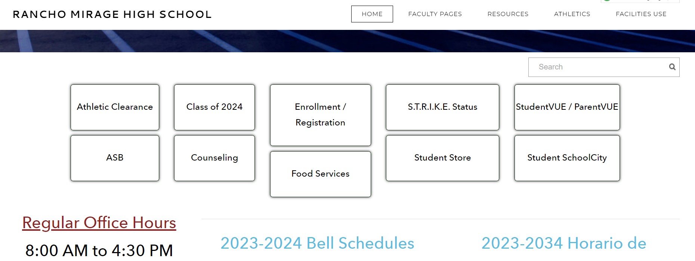
Website: rmhs.us
For Current Information visit the website

Slide 3
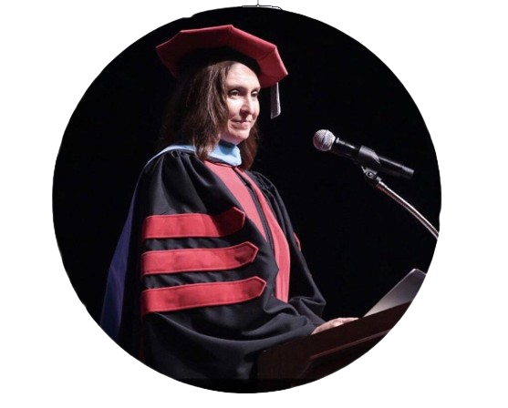
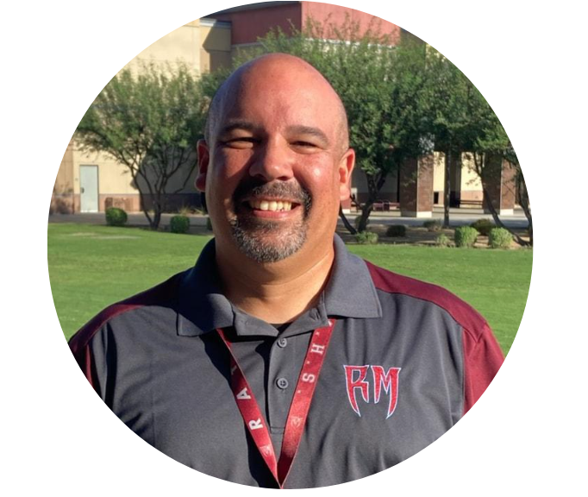
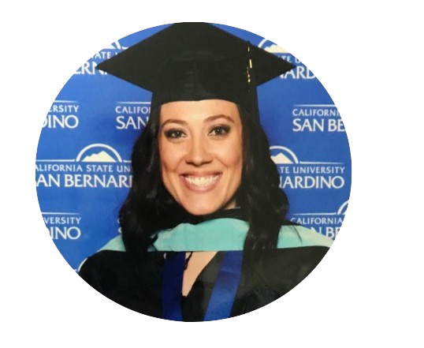
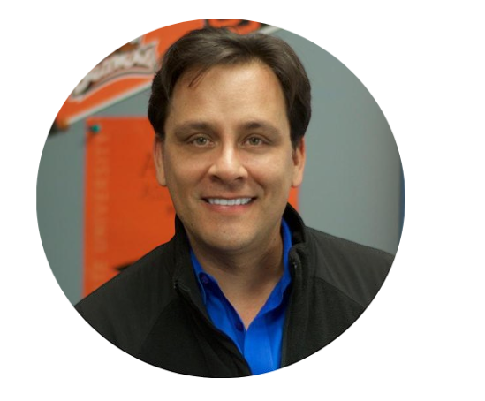
Administration team
Dr. Teresa Haga
Principal
Mr. Eddie Martinez
Assistant Principal &
Athletic Director
Ms. Kim Ballard
Assistant Principal
Ms. Angela Garbe
Dean of Students
Dr. Julio Omier
Assistant Principal

Slide 4
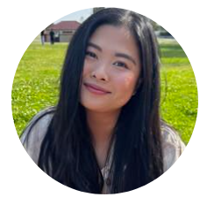
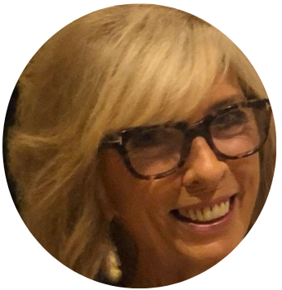
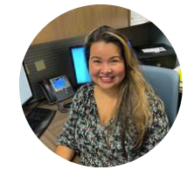
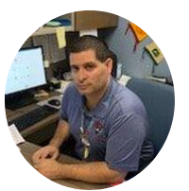
Counseling team
Ms. Huynh
A-Diaz, AVID
Special Education 12th
Ms. Watson
Lopez-Ramirez, Advanced Performing Arts,
Special Education: 10th
Mrs. Garcia
DiB-Long, RACE Academy,
TTECHS, Advanced Theater,
SMART program,
Special Education 9th
Mr. Solis
Ramos-Z, CAFE Academy,
Special Education 11th

Slide 5
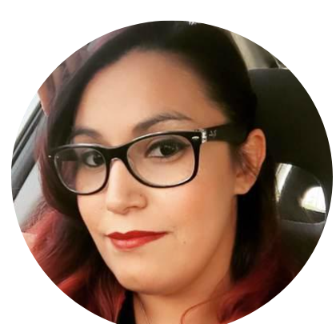
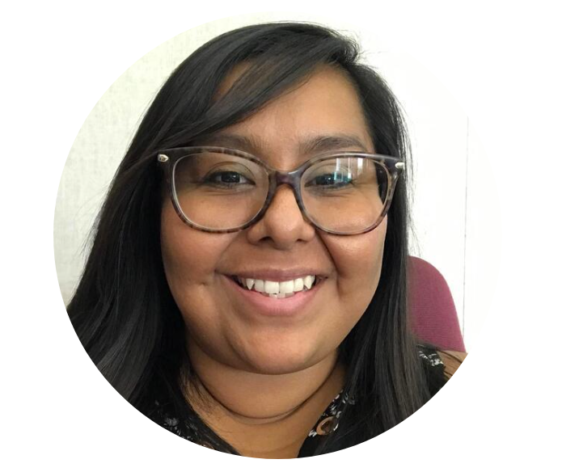
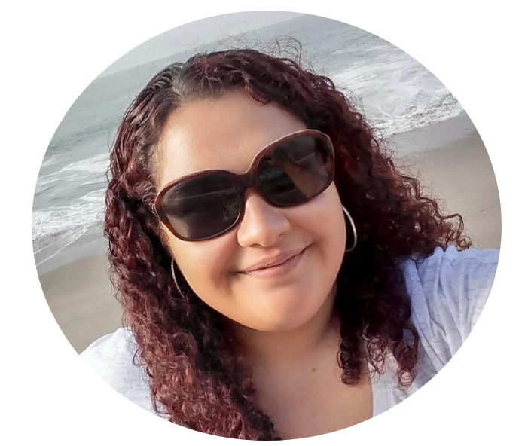
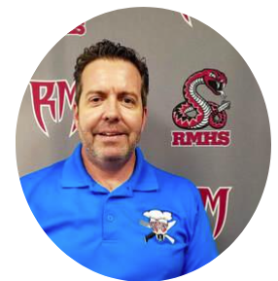
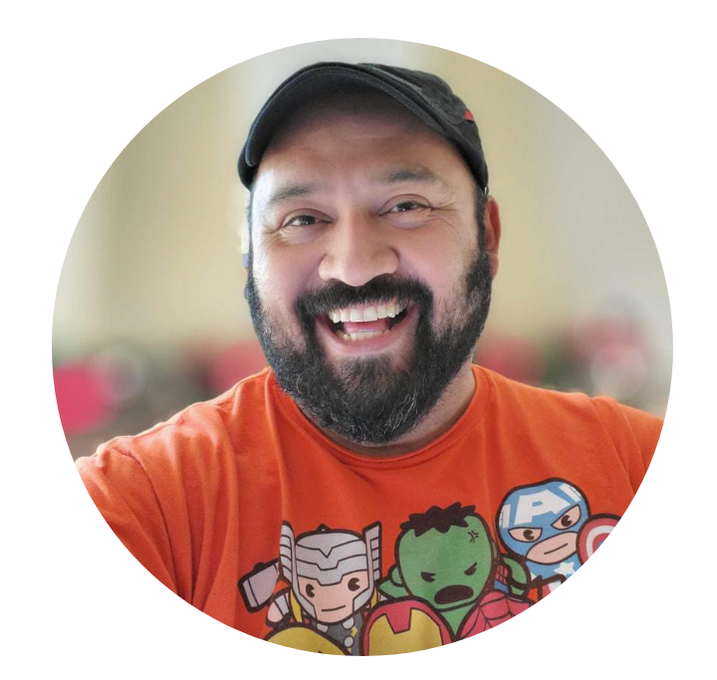
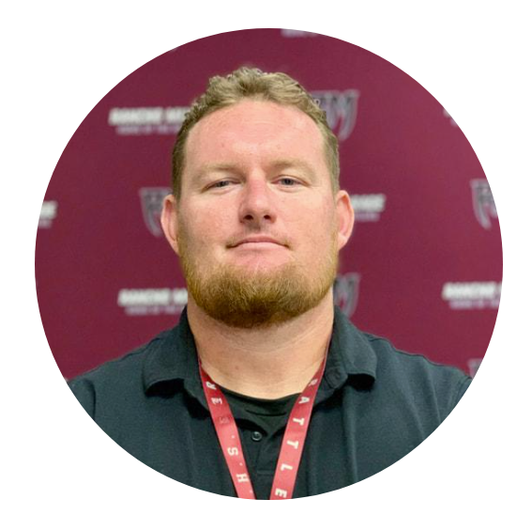
Additional Counseling/Academic Support
Ms. Mocete
MTSS Coach, 11th/12th Grade
(Multi-tiered system of support)
Mrs. Quinn
Targeted Counselor
9th/10th Grade
Ms. Henderson
College and Career Specialist
Mr. Silva
Counselor on Special Assignment
English Learners
Mr. Carrick
Prevention Specialists
Supports all students
Mr. Jeff Kabel
Work-Based Learning

Slide 6
Graduation Requirements (PSUSD Requirements)
✅225 Credits ✅≥1.51 GPA ✅Pass IM1 or equivalent (Algebra 1)
RMHS Student-Parent Handbook
Page 25
1 class = 10 credits per year
Or 5 credits per semester.
Students take 6 class and can earn 60 credits in one year.

Slide 7
FOUR YEAR PLAN (with help from your counselor)
class | 9th Grade | 10th Grade | 11th Grade | 12th Grade
1 | English 1 | English 2
2 | Living Earth | Chemistry
3 | Spanish 1 | Spanish 2
4 | Integrated Math 1 | Integrated Math 2
5 | PE | World History
6 | Art 1 | Academy class
SS | Integrated Math 1- S1
Total | 60 credits | 120 credits | 180 credits | 240 credits

Slide 8
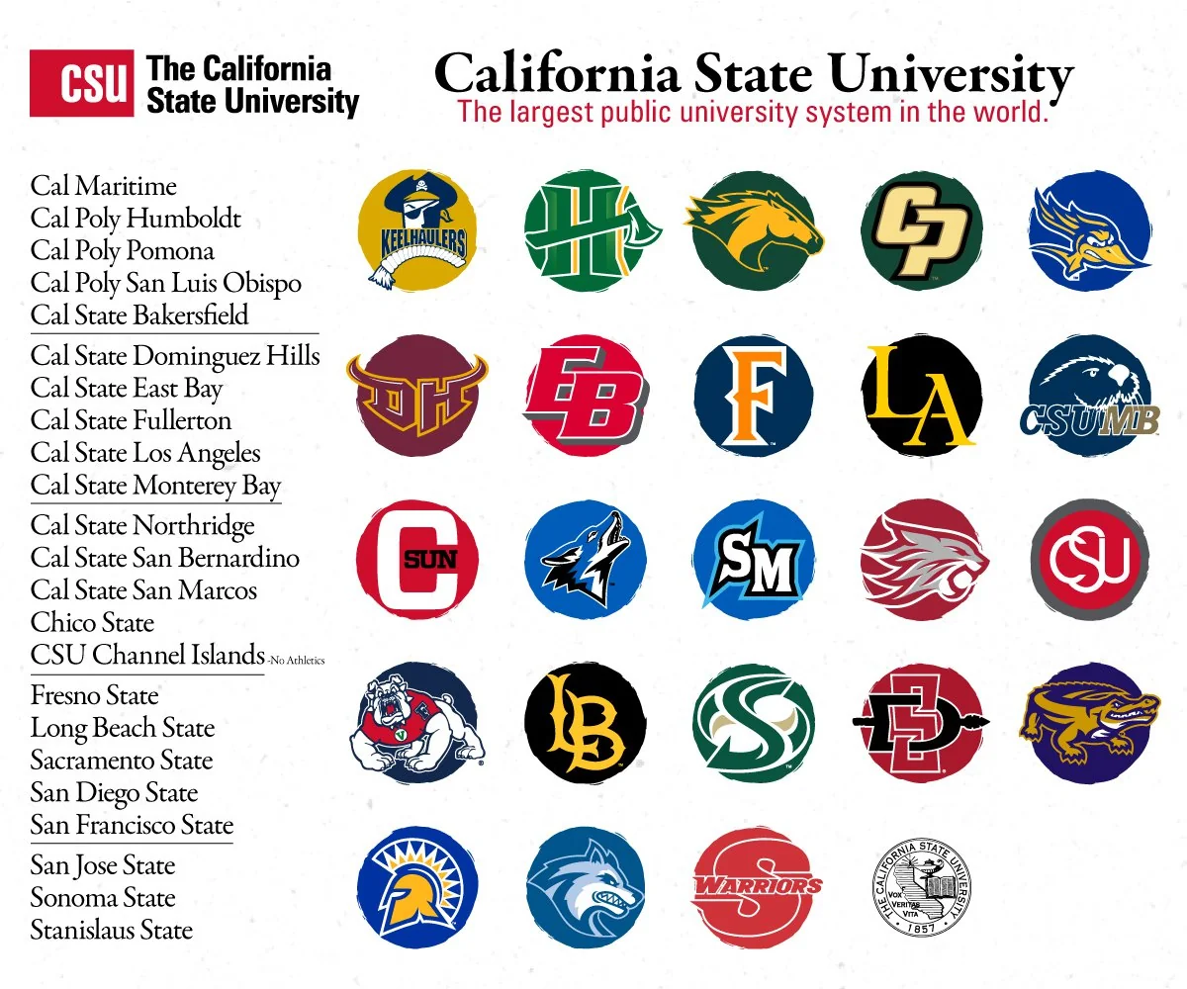
A-G Requirements (Admission to a UC or CSU school)
✅150 Credits ✅Grades: C or better
A-G requirements provide evidence to our California State Universities (CSU) and University of California (UC) schools that students are academically ready for post secondary school by meeting minimum requirements in specific courses with a C or better.

Slide 9
A-G Requirements
class | Subject | Years | Credits
A | History | 2 years | 20
B | English | 4 years | 40
C | Math | 3⁺ years | 30
D | Science (Life & Physical) | 2⁺ years | 20
E | Language other than English | 2⁺ years | 20
F | Visual/Performing Arts | 1⁺ year | 10
G | College Prep Elective | 1 year | 10
All grades must be a C or better! |  |  | 150 credits
HS Graduation credit requirement
History: 30
English: 40
Math: 30
Science 20
LOTE: 10 or
VAPA: 10
PE: 20
Electives: 75 credits
225 credits

Slide 10
Questions on
HS Graduation or A-G?

Slide 11
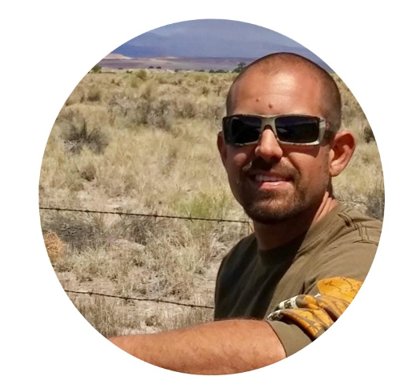
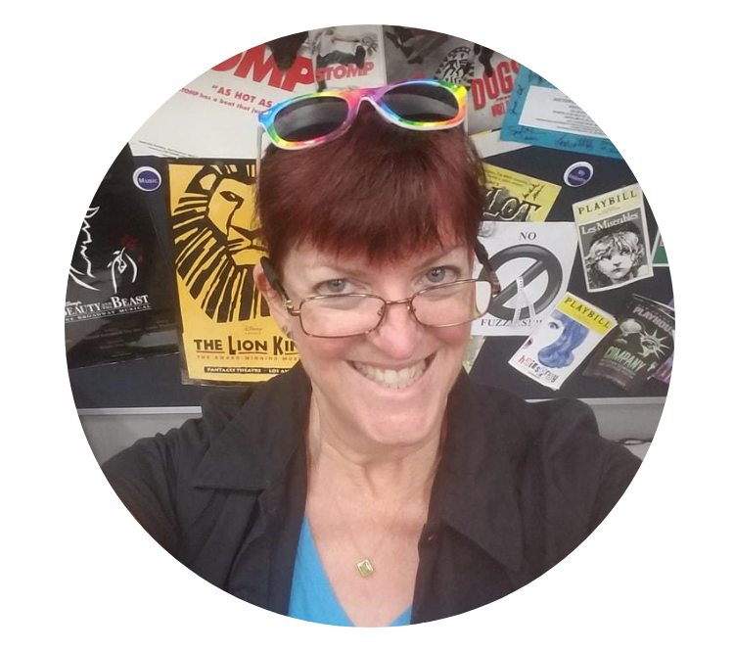
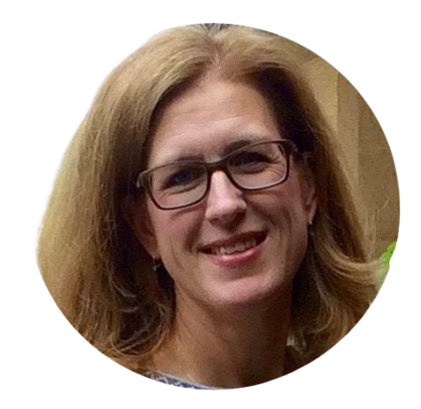
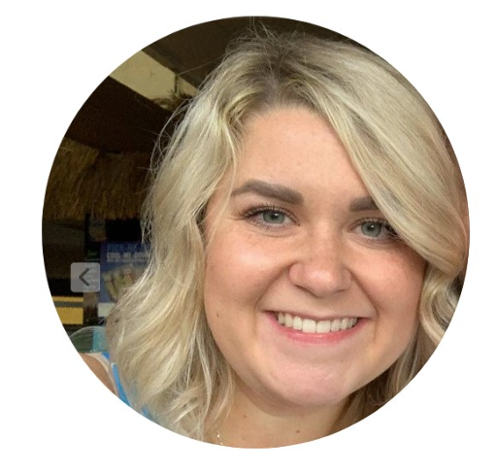
Rancho Mirage High School Academies
TTECHS
Technical Theater Education & Careers for High School Students
AVID
Advance via Individual Determination
CAFE
Culinary Arts Food Education
RACE
Rattler Automotive Careers Education
Chef Van Loon
10-12 grade
Mr. Bodnar
10-12 grade
Mrs. Newhouse
9-12 grade
Mrs. Robinson
Mrs. Sandoval
9-12 grade

Slide 12
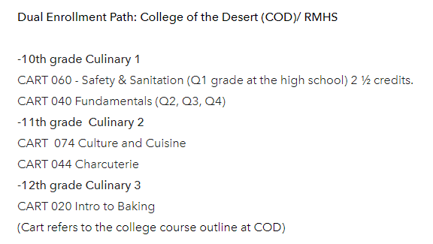
CAFE: https://cafeacademy.weebly.com/
Instructor: Chef Jenna Van Loon | Counselor: Mr. Solis
3 year program through COD (10th-12th)
The RMHS Culinary Arts For Education (CAFE) program is a professional learning environment designed to foster full student potential through rigorous and relevant academics and work-based experience in order to empower, inspire, and prepare our students for post-graduate college or career paths in the hospitality industry.

Slide 13
RACE: https://rmhsraceacademy.weebly.com/
Instructor: Will Bodnar | Counselor: Mrs. Garcia
3 year program through COD ( 10th-12th)
Automotive 010
This course covers the fundamentals and basic knowledge of the automotive repair trade. It includes shop safety, hand tools, fasteners, shop math, and an overview of basic automotive systems.
Automotive 012
This course provides theory and hands-on experience in automotive steering and suspension systems including: theory of operation, service, diagnosis and repair.
Automotive 013
This course covers the basic fundamentals and basic knowledge of the automotive repair trade for the braking system. It includes discussion, demonstrations and hands-on laboratory practice, shop safety, hand tools, hydraulic principles, shop math, brake system principles, system diagnosis and repair, basic electrical, wiring schematics and electrical diagnosis.
The RMHS Rattler Automotive Careers Education (RACE) program is a professional learning environment designed to foster full student potential through rigorous and relevant academics and work-based experience in order to empower, inspire, and prepare our students for post-graduate college or career paths in the automotive industry.

Slide 14
TTECHS: https://rmhstheaterclasses.weebly.com/
Instructors: Mrs. Newhouse | Counselor: Mrs. Garcia
Students can participate in grades 9-12
The TTECHS Career Pathway at Rancho Mirage High School gives students an opportunity to learn about technical theatre/entertainment industry while providing real life-skills needed to enter college or employment in the industry. Interacting with the community through production support, field trips, and mentors allows TTECHS students to develop both technical and employability skills needed to succeed in the field.
What are some things I can learn in TTECHS?
The TTECHS Pathway offers students both academic and professional skills that apply to subjects such as mathematics and physics. The curriculum features a hybrid of solid academics and professional training to provide hands-on experience in the tech theatre/entertainment industry.
Students are expected to master basic construction and measurement skills while utilizing basic hand tools, power tools, and other equipment to complete required stage tasks.

Slide 15
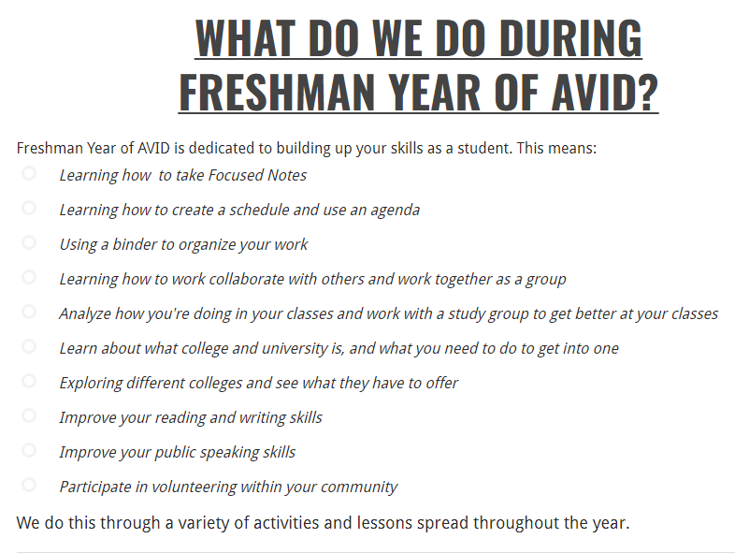
AVID: http://avidrmhs.weebly.com/
Instructors: Mrs. Robinson, Mrs. Sandoval
Counselor: Ms. Huynh
AVID, Advancement via Individual Determination, is a national program that works to help motivated students become college and career ready. This program, which is an elective class taken each year during high school, focuses on building student's skills in writing, inquiry, collaboration, organization, and reading through a challenging curriculum and activities. Students are expected to take challenging courses, work together with their classmates and AVID family, and participate in volunteer work and extracurricular activities.

Slide 16
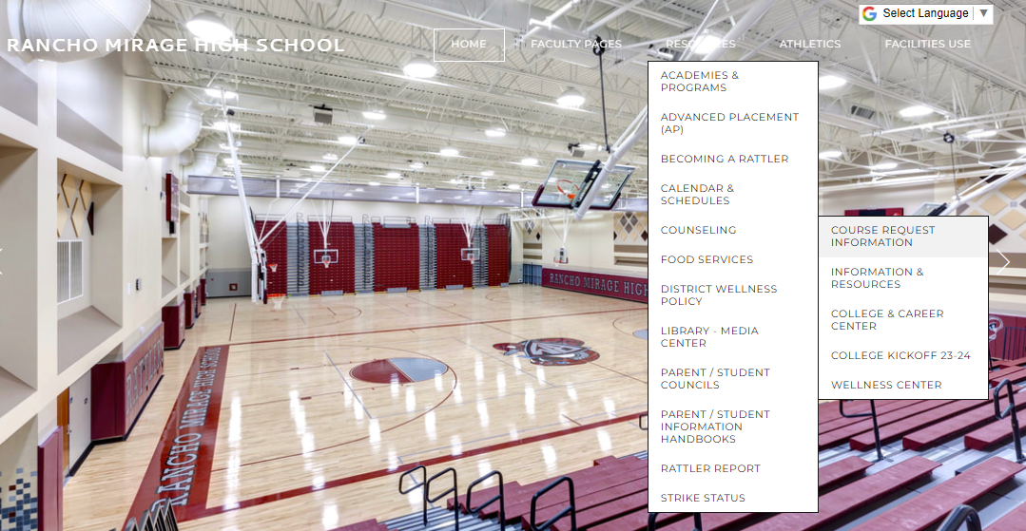
Rmhs.us > Resources > Counseling > Course Request Info

Slide 17
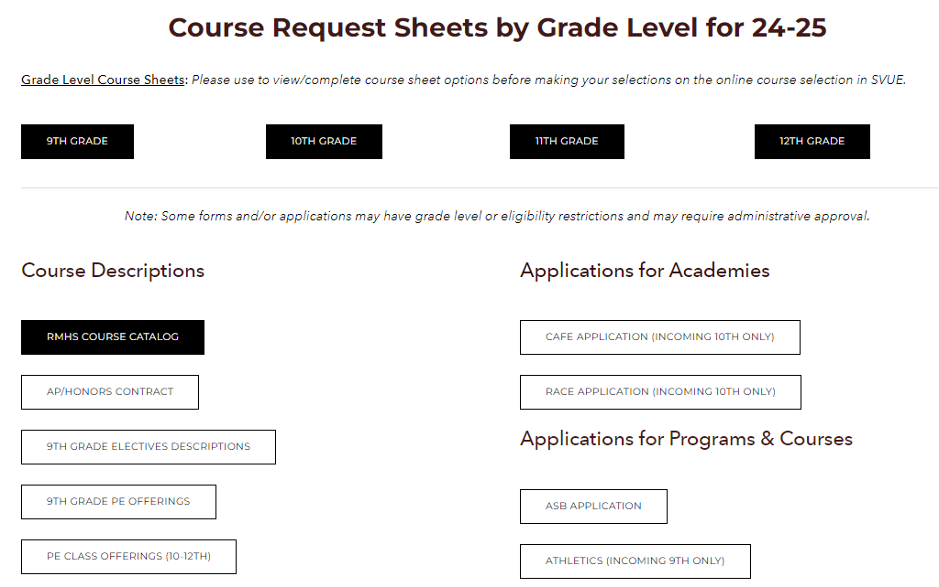
Resources and Information
TUESDAY MARCH 19th
NCMS VISIT

Slide 18
Questions on
Academies?

